Slide 1
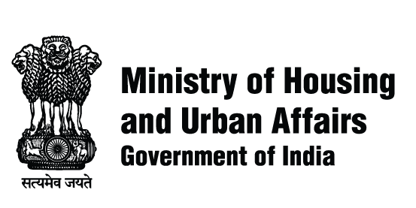
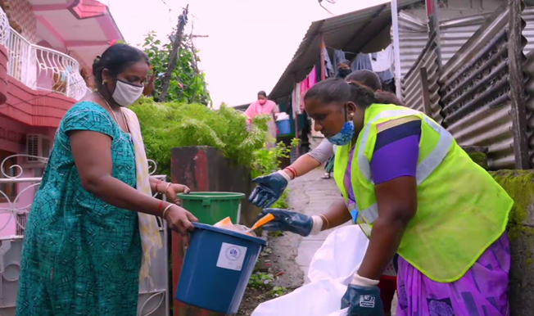
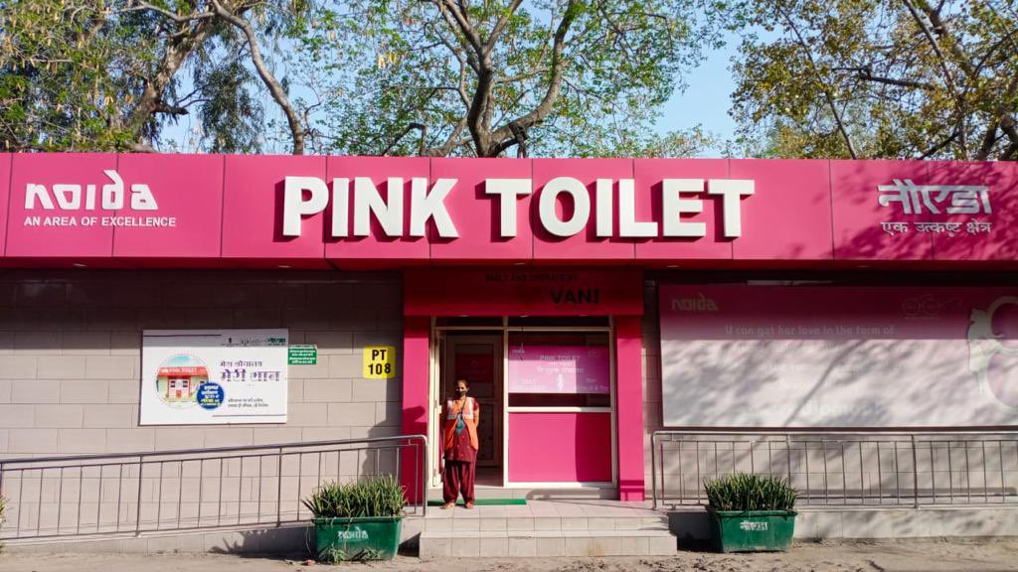
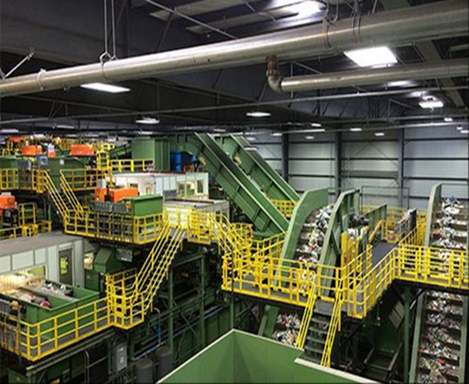
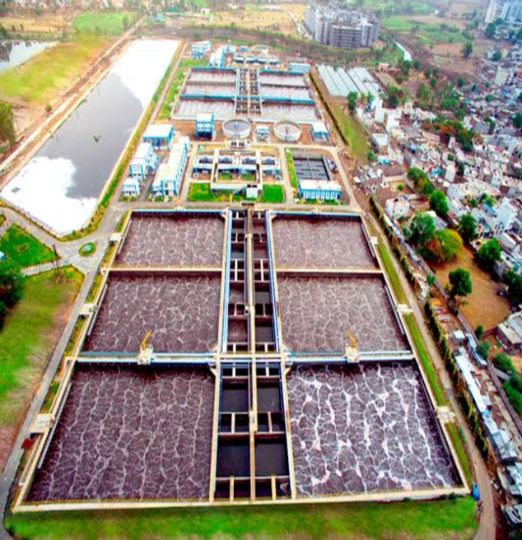
Convergence of Govt. programs- Civic infrastructure
29 March 2023

Slide 2
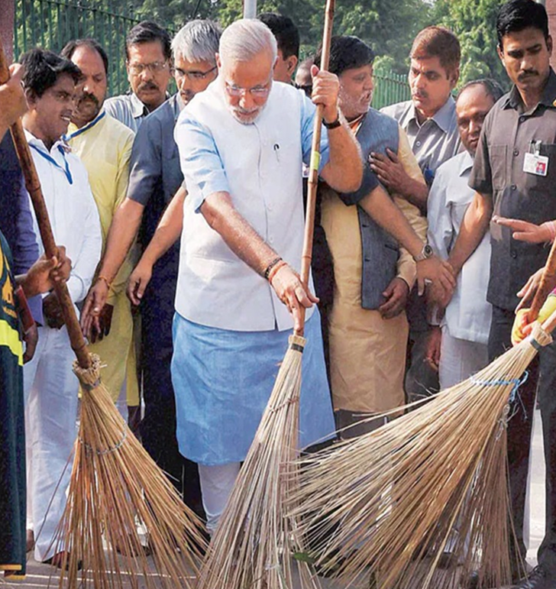
Swachh Bharat Mission – Urban
Focus Areas
Individual household toilets
Community & public toilets
1
2
Solid Waste Management
Information, Education and Communication
3
4
5
Capacity Building
GoI Share
₹ 14,623 crore
Centre share released
₹12,331.66 crore (84%)
Other shares
₹ 47,386 crore
UC Received
₹ 9,631.26 crore (78%)
*percentages are calculated w.r.t Revised expenditure

Slide 3
SBM- Urban 2.0 Vision: ‘Garbage Free Cities’
1
5
Door to door collection
Source segregation of waste
Functional Public Toilets
2
6
Solid waste management
UWM in small cities
3
7
Remediation of legacy dumpsites
‘Manhole to Machinehole’
4
In 154 cities:
Mechanized sweeping
C&D waste processing
8
Behaviour change & Capacity Building

Slide 4
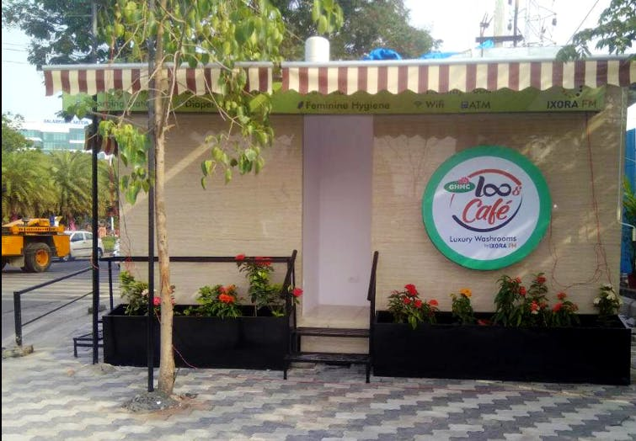
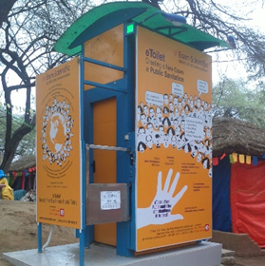
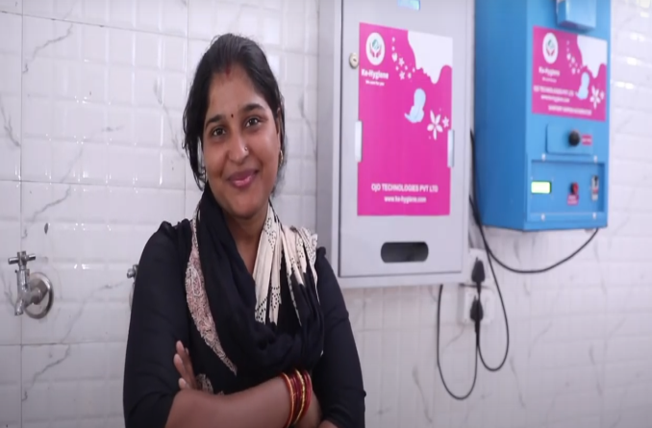
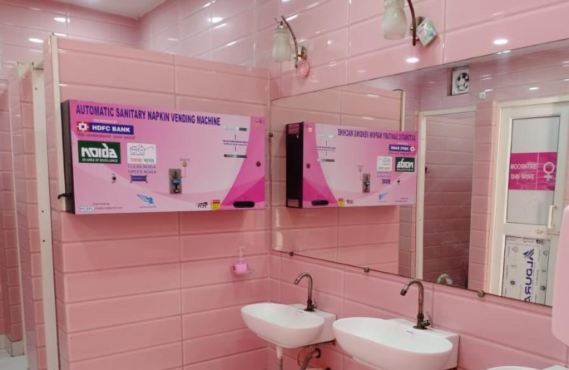
Toilets 2.0
IHHL
CT/PT
66.98 Lakh IHHL units (113% progress)
6.47 lakh CT/PT seats (127% progress)
4,715 cities declared Open Defecation Free (ODF)
Focus on O&M model of toilets
Aspirational toilets in high footfall areas/ tourist spots
Mobile toilets for large gatherings
67,407+ toilet blocks from 3,326+ cities mapped on Google Maps

Slide 5
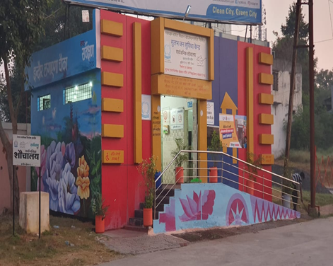
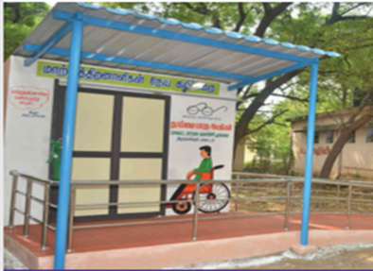
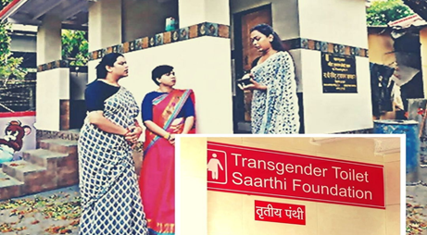
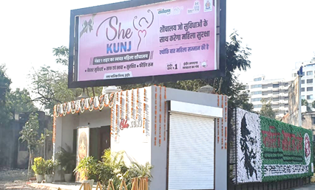
Aspirational Toilets
Water and energy efficient toilet designs (water reuse for flushing purposes and use of solar panels for electricity)
Inclusive and user friendly toilets designs for senior citizens, children, women and transgenders
Automated low-Maintenance e-Toilets and use of Internet of Things (IoT) and Artificial Intelligence (AI) for maintenance of toilets
Self- sustaining revenue generating O&M models (recovery of user charges via commercial activities, advertisements etc.)
Digital and continuous monitoring of toilet via ICT based feedback system

Slide 6
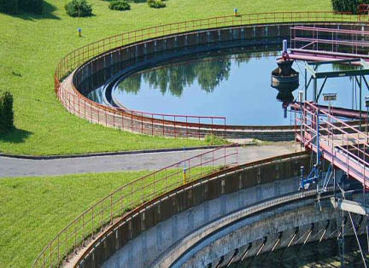
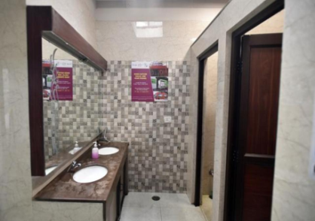
ODF Sustainability: Robust Monitoring Protocols
ODF
ODF+
ODF++
Water+
ODF &
Functionality of Community and Public Toilets
ODF+ &
Containment and Treatment
ODF++ &
At least 20% usage of treated water
Access to toilet facilities for all
4,715 cities
3,547 cities
1,191 cities
14 cities

Slide 7
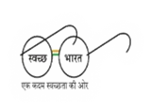
CSAP 3A Summary Sheet -Toilets
Summary of Toilets (CSAP 3A) | Total No. of States/Uts | Sum of Total No. of ULBs | No of ULBs Plan Approved by the Ministry | Central Share/Mission allocation (in CR) | Total Project Cost (in Cr.) | Central share sanctioned (in Cr.) | % of Central share sanctioned
Total | 19 | 3,826 | 3,142 | 1,172.1 | 2,520.215 | 726.49 | 61%
Summary of Toilets (CSAP 3A) | Sum of IHHL (no. of units/seats) | Sum of CT/PT(No. of units/seats) | Sum of Aspirational PTs (no. of units/seats) | Sum of Standalone Urinals (no. of units/seats)
Grand total | 4,94,747 | 63,941 | 19,381 | 27,741
Post 8th NARC, fresh proposals status : West Bengal proposals for 128 ULBs is under examination. Karnataka & Sikkim awaiting MoM and requisition letter to initiate examination

Slide 8
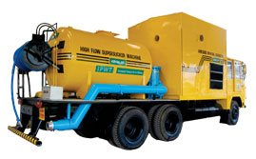
SafaiMitra Suraksha
1,120 cities declared as Safaimitra Surakshit Shehar
Institutional Interventions
Manpower-related Interventions
Mechanisation Interventions
http://sss.sbmurban.org/
Budget Announcement
Manhole to Machinehole - Mechanical desludging of septic tanks and sewers in all urban areas
940 desludging vehicles approved

Slide 9
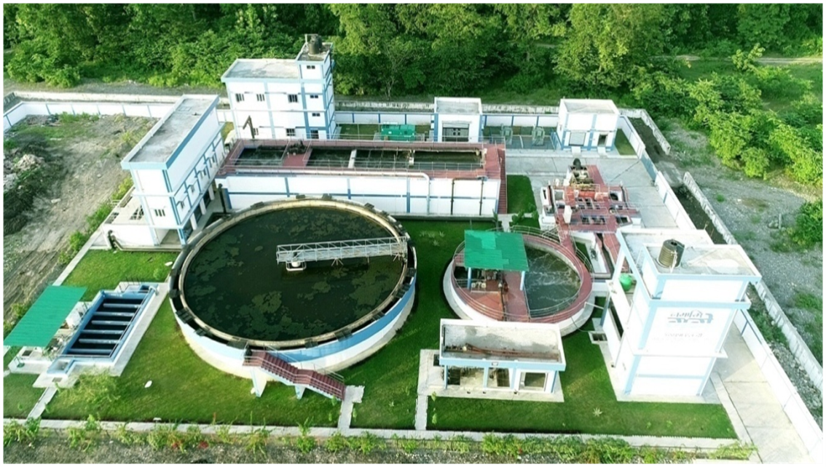
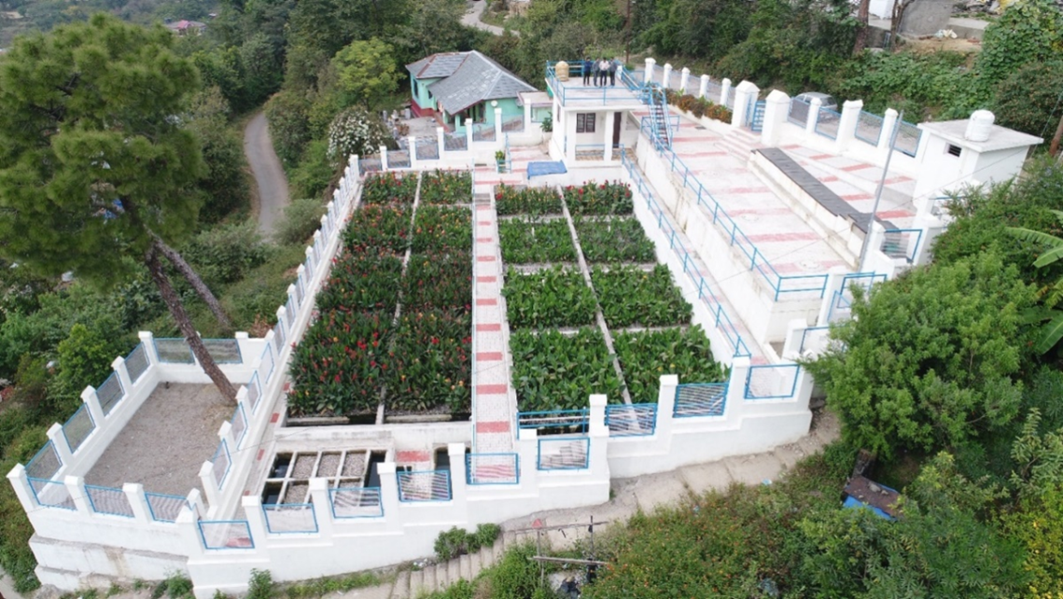
Used Water Management
For cities with less than 1 lakh population.
Funds provided for STPs, I&D and desludging vehicles
Target - 13,000 MLD by 2026
20% reuse of treated water
Muni-ki-Reti, Uttarakhand
Approved Capacity 4920 MLD
Approved Project Cost ₹ 11,785 Cr.
Dharamshala, Himachal Pradesh

Slide 10
Swachhata
Reaching every home, street & neighborhood
Total Wards
91,845
89,159 wards
(89%)
82,442 wards
Door to Door Collection (Wards)
(97%)
Source Segregation (Wards)
Negligible
Negligible
2014-15
2022-23
(Till Date)
2014-15
2022-23
(Till Date)

Slide 11
Swachh Bharat Mission
Fueling the Circular Economy
Total Waste Generated
1.52 lakh TPD
Waste processing integrated into city action plans
Shift from dumping of waste to processing
Women SHGs and informal sector getting employment, improved earnings and dignity
Waste Processing
75%
16%
2014-16
2014-15
2022-23
(Till Date)
Budget Announcement
Promoting Circular Economy - Scientific processing of dry and wet waste

Slide 12
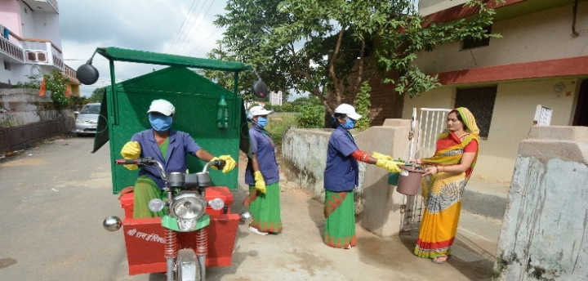
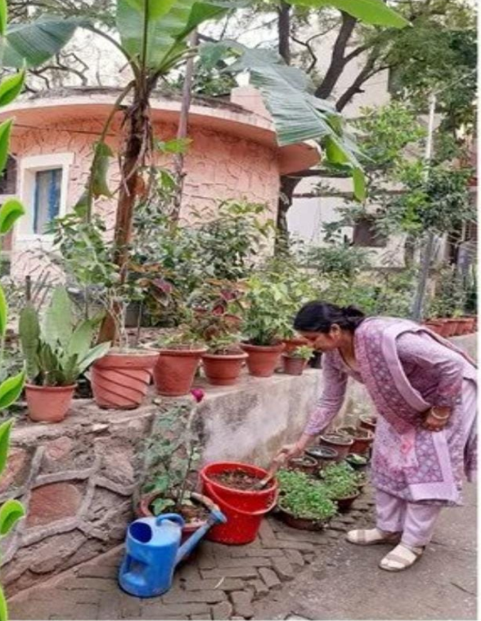
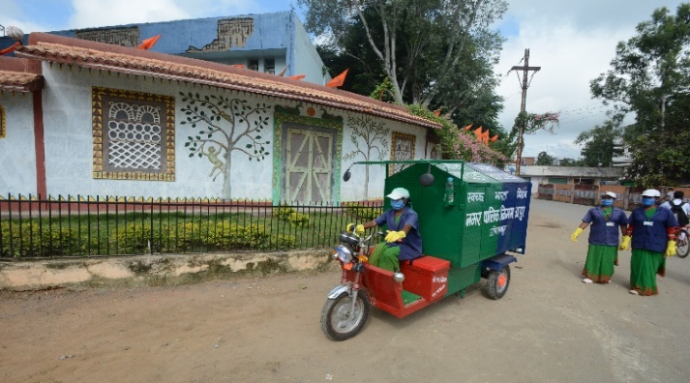
Star Rating Certification for Garbage Free Cities
5 Star Cities
Ambikapur
Bhopal
Mysuru
Navi Mumbai
NDMC
Noida
Patan
Surat
Tirupati
Vijayawada
Vishakhapatnam
Star Rating | 445-Cities Certified (one time certified)
7-Star | 1 (Indore)
5- Star | 11
3-Star | 199
1-Star | 234

Slide 13
Swachh Survekshan (SS)
Survey conducted by 3rd Party Assessment Agency
Enabler for Mission acceleration
Fosters healthy competition
Large scale citizen participation
Creates awareness
Focus on Ganga Towns
Promoting competition amongst small cities
Identifying fast movers
TBD: To be decided , TBA: To be announced
No. 1 : Indore
SS results Dashboard
https://www.sbmurban.org/ss-2022-result-dashboard

Slide 14
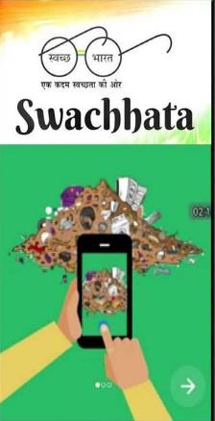
Swachhata App
App for Swachhata related Grievance of citizens
Only Mobile App for Grievance Redressal for ~3800 smaller cities
2.08 Cr+ Citizens Registered
2.5 Cr+ Complaints Posted
>93% Complaint Resolution Rate
~600 City Apps Integrated

Slide 15
Thank You
Website: https://sbmurban.org
Swachh Bharat Mission - Urban
@SwachhBharatGov
Swachh Bharat Mission-Urban

